Slide 1

Project 2:
Stock Market
By: Umesh Uday Salvi
UNID: UM2025045

Slide 2
Table of Content
Introduction
Data Sources
Key Metrics
Outcomes

Slide 3
Introduction
Stock-Market Data Analysis Dashboard is designed to offer a distinctive view of the Stock-Market performance of various entities.
Stock-Market Data Analysis Dashboard created with the assistance of Data Visualization Tool named Tableau.
Dashboard as earlier mentioned gives an overview of the Stock Price movement on Daily basis across different entities such as Apple, Google, Microsoft, Netflix.

Slide 4
Data Sources
Data Visualization tools used for creating Stock-Market Data Analysis Dashboard is named as Tableau.
Dataset is available, provided by a link. Dataset can be utilized for the creation of the Stock-Market Data Analysis Report.
Connect to Data: Open Tableau, click connect, and import the dataset (CSV, Excel, or Database)

Slide 5
Key Metrics
Stock-Market Data Analysis Dashboard highlights the following key information such as:
Volume Traded Over time
Market share by Company
Market Growth Rate
Daywise Open Price
Daywise Close Price

Slide 6
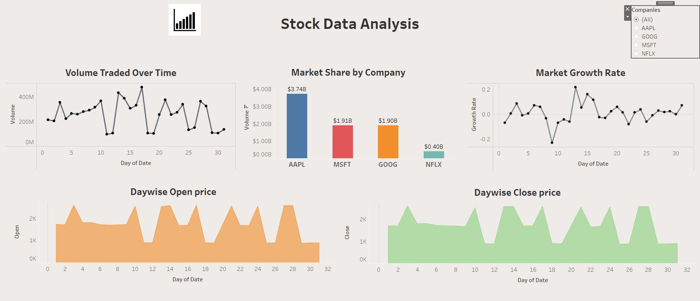
Outcomes: Stock Market Performance

Slide 7
Conclusion
Stock Market Data Analysis Dashboard provides insights related to the stock-market price movement and performance across various different entities, and time interval, with the assistance of the key metrics such as Volume Traded Over Time, Market Share by Company, Market Growth Rate, Daywise Open Price, Daywise Close Price.
Necessary adjustments can be made to improve the performance of the companies, this can be accomplished by predicting the day wise price movements of the various entities

